Slide 1




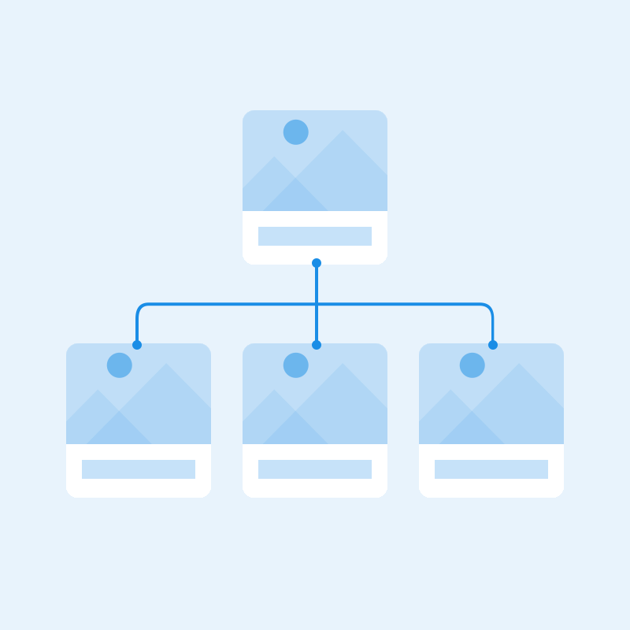



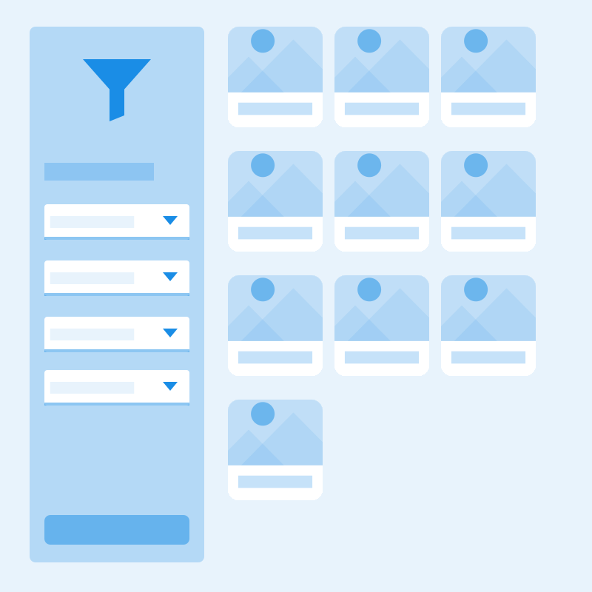

Upload
Text
Team
Success
Sitemap
Sitemap
Profile
About
Filter
Line chart

Slide 2






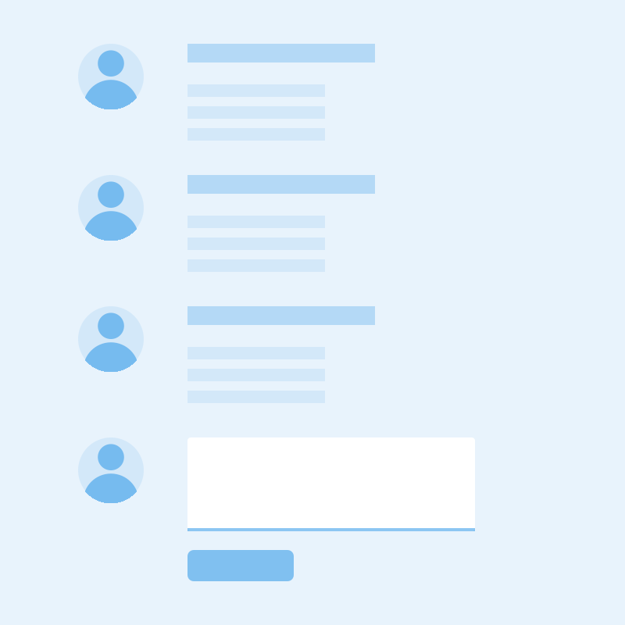



Alert
Compare
File
Calendar
Chat
Files
Comments
Article
Download
Gallery

Slide 3
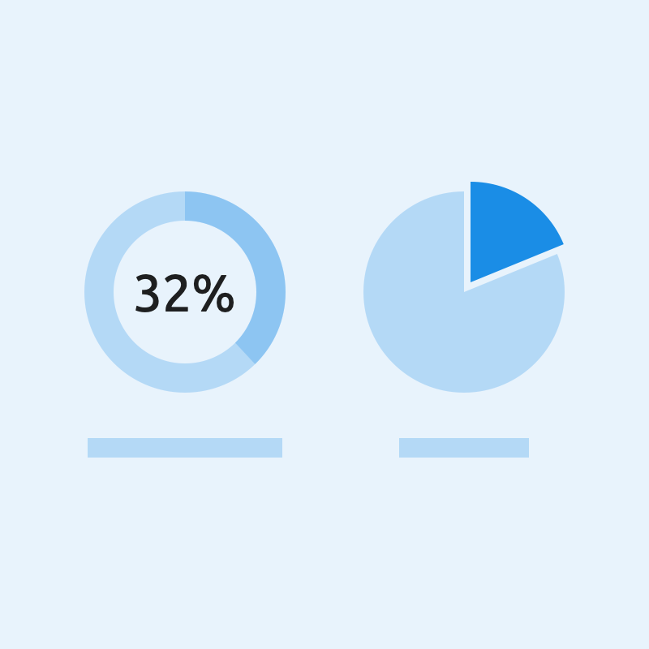



Pie chart
Modal
Login
Form

